Slide 1
Predicting Chronic Kidney Disease (CKD) Using Supervised Machine Learning Techniques
By: Kyla Hallam
Github Repo Link: https://github.com/kylahallam/DTSA5509-Final-Project

Slide 2
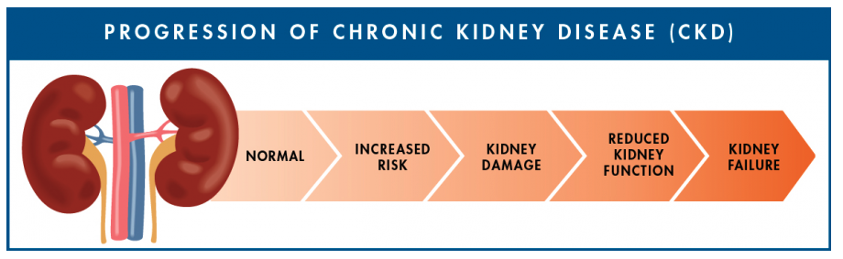
Project Overview
Motivation: Evaluate and Compare three different machine learning methods to predict instances of Chronic Kidney Disease (CKD)
Type of Problem: Binary Classification (i.e. CKD or Not CKD)
Why?
Kidneys play an important role in the human body, acting as filters to remove waste from the body
Chronic Kidney Disease (CKD) is a disease that impacts the kidney’s ability to excrete and remove waste products. The complications of CKD can be severe and lead to death.
Predicting CKD is an excellent example of where a binary class classification model could be used to address a real world problem.
Figure Source: https://www.cdc.gov/kidneydisease/prevention-risk.html

Slide 3
Overview of Models
Three different machine learning models were used to perform binary class classification to predict Chronic Kidney Disease:
The models were chosen after completing the data cleaning and Exploratory Data Analysis (EDA), in careful consideration of the size of the data set, number of features, and problem type (classification).
Type of Model | Model Name | Hyper Parameters | Description
Parametric | Logistic Regression | No | Simple model
Non Parametric | Decision Tree Classifier | Yes | Tree Model
 | Random Forest Classifier | Yes | Ensemble Tree Model

Slide 4
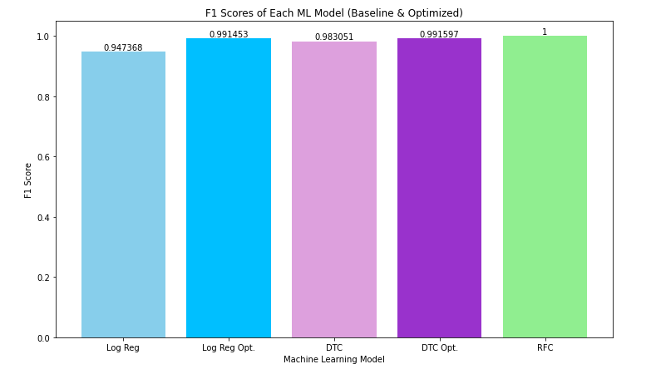
F1 Performance Comparison
Logistic Regression
Baseline model had an F1 score of 94.7%
F1 score shows the precision/recall capabilities of the model and was used as the metric of interest due to class imbalance in the dataset
Optimization of the logistic regression model was based on feature selection (feature engineering) and 5 fold Cross Validation after feature selection was completed.
Model improved to 99.1% after optimization.

Slide 5
F1 Performance Comparison
Decision Tree Classifier
Baseline model had an F1 score of 98.3%
F1 score shows the precision/recall capabilities of the model and was used as the metric of interest due to class imbalance in the dataset
Optimization of the Decision Tree was based on the hyperparameter optimization of number of features and loss criterion.
Model improved to an F1 of 99.1% after optimization.

Slide 6
F1 Performance Comparison
Random Forest Classifier
Baseline model had an F1 score of 100%
F1 score shows the precision/recall capabilities of the model and was used as the metric of interest due to class imbalance in the dataset
No optimization was needed since the F1 score and accuracy were 100% with the baseline model
This is a non parametric, ensemble method making it a strong choice for the CKD data set which had mild collinearity and skewness.

Slide 7
F1 Performance Comparison
Model Comparison:
Each model showed improvement after model optimization (if applicable)
The Random Forest Classifier without optimization outperforms the logistic regression with optimization.
The Random Forest Classifier is an ensemble method and is robust against feature collinearity
The dataset exhibited mild collinearity which could have negatively affected the logistic regression model (since it is linear)
Both Non Parametric models outperform the parametric model (logistic regression), suggesting that the best choice of model for this dataset is a non parametric model.

Slide 8
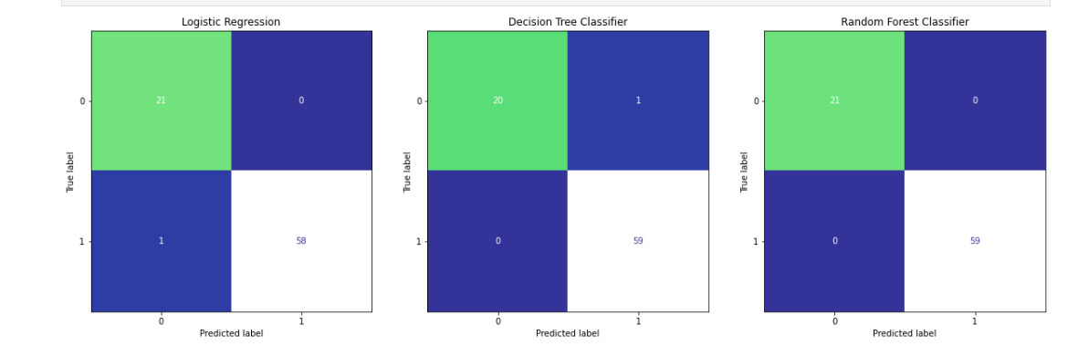
Comparison of Confusion Matrices
Number of False Negatives (FN) is an important metric for evaluating a medical model’s performance. It is important to minimize the number of FN to avoid missing a diagnosis for any patient with CKD. With this metric in mind, the Random Forest Classifier outperforms the other models that were considered.

Slide 9
Summary
Accomplished the objective of evaluating three different machine learning models in their ability to predict instances of Chronic Kidney Disease (CKD)
The Random Forest Classifier is the best choice of the models evaluated in this project
The Random Forest Classifier has the best F1 score (100%)
The Random Forest Classifier does not have any instances of False Positives
Did not require any hyperparameter optimization to achieve this score
Given the size of the data set and type of problem, the model choices were appropriate and allowed for a comparison of different machine learning methods.

Slide 10
Project Sources
1. Brownlee, J. (2021, January 4). Random oversampling and undersampling for imbalanced classification. Machine Learning Mastery. Retrieved August 6, 2022, from https://machinelearningmastery.com/random-oversampling-and-undersampling-for-imbalanced-classification/#:~:text=Random%20oversampling%20involves%20randomly%20selecting,them%20from%20the%20training%20dataset.
2. Centers for Disease Control and Prevention. (2022, February 28). Chronic kidney disease basics. Centers for Disease Control and Prevention. Retrieved August 6, 2022, from https://www.cdc.gov/kidneydisease/basics.html
3. Detecting multicollinearity with VIF - python. GeeksforGeeks. (2020, August 29). Retrieved August 6, 2022, from https://www.geeksforgeeks.org/detecting-multicollinearity-with-vif-python/
4. Dua, D. and Graff, C. (2019). UCI Machine Learning Repository [http://archive.ics.uci.edu/ml]. Irvine, CA: University of California, School of
Information and Computer Science.
5. Iqbal, M. (2017, April 13). Chronic kidney disease dataset. Kaggle. Retrieved August 6, 2022, from https://www.kaggle.com/datasets/mansoordaku/ckdisease
6. James, G., Hastie, T. J., Tibshirani, R., Witten, D. (2021). An Introduction to Statistical Learning: With Applications in R. Springer.
7. Nighania, K. (2019, January 30). Various ways to evaluate a machine learning models performance. Medium. Retrieved August 6, 2022, from https://towardsdatascience.com/various-ways-to-evaluate-a-machine-learning-models-performance-230449055f15
8. U.S. Department of Health and Human Services. (n.d.). Chronic kidney disease (CKD). National Institute of Diabetes and Digestive and Kidney Diseases. Retrieved August 6, 2022, from https://www.niddk.nih.gov/health-information/kidney-disease/chronic-kidney-disease-ckd#:~:text=Chronic%20kidney%20disease%20(CKD)%20means,family%20history%20of%20kidney%20failure.

